Slide 1
Application Security Verification Standard 4.0
Josh Grossman, OWASP ASVS Project co-leader
September 2019 – OWASP Helsinki
Notes:
Intro
What is the ASVS
Highlight key changes

Slide 2


Slide 3

Josh Grossman
Over 10 years of IT Security, IT Risk and development experience
Application Security Consultant and Head of Security Services for AppSec Labs
Consulting for clients internationally and locally

Slide 4

Josh Grossman

Slide 5

Josh Grossman
Co-leader of the OWASP ASVS Project
Major Contributor to the OWASP Top Ten Proactive Controls project
Contributor to the OWASP Top 10 Risks and OWASP JuiceShop projects

Slide 6
What is the ASVS?
Designed to be an actual application security standard
Set of leading practices
Community and Industry Driven
Completely developed in the open at GitHub
Submit issues! Submit PRs! Translate please!
Notes:
Less well known but important
Top 10 is just awareness
Things that should become the norm, eye on 2021, 2022
Things that you might not expect
An actual standard
Driven by the community, many eyes

Slide 7
Who is involved?
Andrew van der Stock, Daniel Cuthbert, Jim Manico, Josh Grossman, Mark Burnett
Amazing contributors and reviewers such as Abhay Bhargarv, Elar Lang, ossie-git, Ron Perris, Tonimir Kisasondi, Serg Belokamen, Jason Axley, and Adam Caudill
You
Thanks to Andrew van der Stock for the slides that I based this deck on ☺
Notes:
No watering down

Slide 8
So what’s new?

Slide 9
What’s new
Now completely written in Markdown
Uses MASVS script and CSV generation
Easy to translate
Easy to determine what changed, when, by whom, and why
NIST 800-63b compliance
IoT ASVS Preview Chapter
Notes:
Shout out to Sven and Jeroen
Previously a big word doc
Easy to contribute, incremental changes
Digital Identity Guidelines: Authentication and Lifecycle Management
More about NIST later

Slide 10
Modern web applications
Full support for server-less, responsive applications
Containers
API
DOM
Templating
Notes:
Avoid serverside concept

Slide 11
CWE all the things
Most requested feature for the last decade finally delivered
Let’s talk about CWE for a minute
ASVS is a control based standard
Weaknesses are not controls
CWE is an imperfect mapping, but it’s the mapping we have
Not every item ended up with a CWE. CWE needs our help

Slide 12
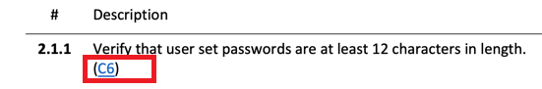
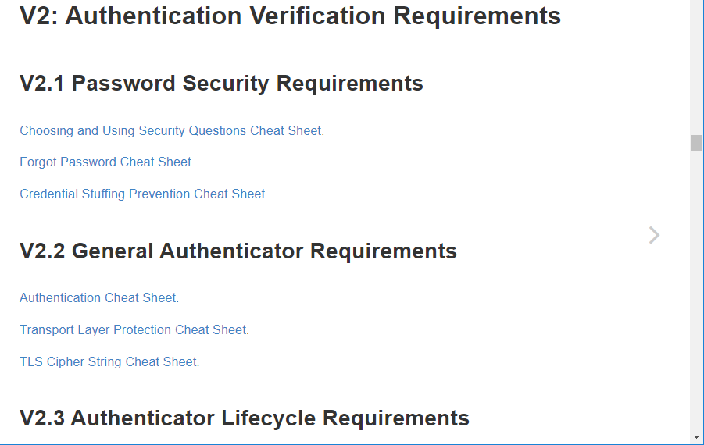
Mappings!
Mapping to cheat sheets project
Mapping ASVS controls to the relevant Proactive Control

Slide 13
What’s changed
Basically everything
Renumbered completely
Each section is reorganized and re-ordered
De-duped. Do not omit any section for your level
Notes:
Use all of the sections

Slide 14
L1 is the new minimum
OWASP Top 10 2017 is simply not sufficient
Level 1 is now completely testable using pentest techniques
It’s the only level that is completely penetration testable
Stop penetration testing. Hybrid reviews at least!

Slide 15
PCI DSS 6.5.x
Yep
We even included buffer overflows, integer and safer string operations, as well as ensuring that folks compiled code properly!
Notes:
Full coverage with some older controls re-added

Slide 16
What’s gone
Less impactful controls
Controls that were implemented by one browser or language
“Since”
Mobile Chapter (use MASVS)
IoT Chapter (use IoT Project)
Notes:
E.g. bug bounty exclusions
“Since when” – make room for CWE and hard with the renumbering

Slide 17
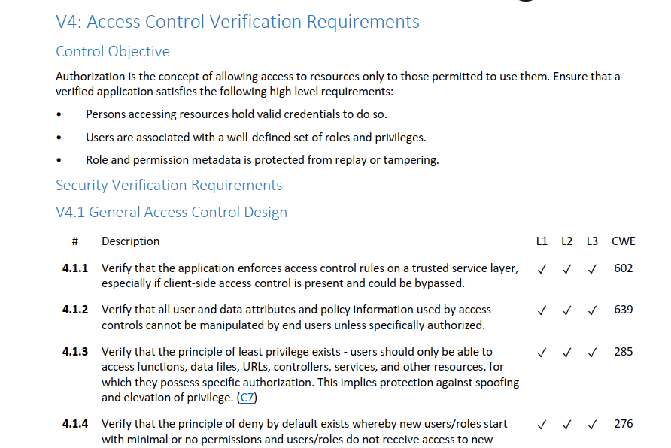
Notes:
This is what it looks like
Authentication
Some intro text and then controls built into sections
ID numbers, Level indicators, mapping to proactive controls, mapping to CWE, NIST mapping

Slide 18
Detailed Changes

Slide 19

V1 Architecture
Notes:
Have to be built in from the start

Slide 20
V1 Architecture
Completely revamped
Replaces “dead” section with something that can produce secure by default software
Requires Secure Software Development Lifecycle
Requires threat modeling
Design and build security in!
Levels 2 and 3 only
Notes:
Have to be built in from the start

Slide 21

V2 Authentication
Notes:
A lot going on
8 characters is a big nope….
Credential stuffing – when was the last time a pen test picked that up for you?

Slide 22
V2 Authentication
Aligned with NIST 800-63b
Except that we had to go to 12 characters for SFA passwords
Credential lifecycle from issuance to retirement
Credential storage requirements
Credential recovery
Credentials construction and protection, including credential stuffing
FIDO support
Notes:
A lot going on
8 characters is a big nope….
Credential stuffing – when was the last time a pen test picked that up for you?

Slide 23
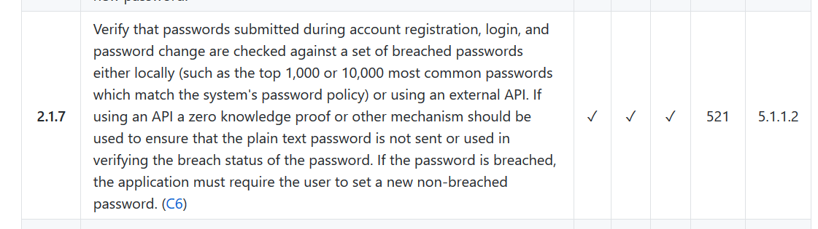
V2 Authentication
Notes:
Compare to known bad lists
haveIbeenpwned
Or top 10000

Slide 24
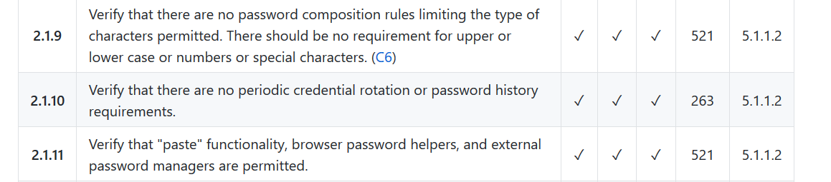
V2 Authentication

Slide 25
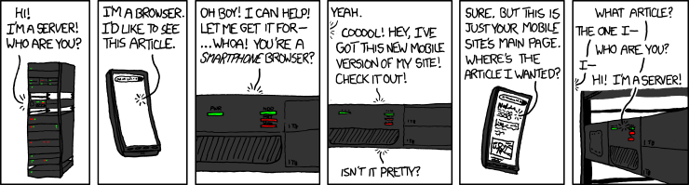
V3 Session Management
https://www.xkcd.com/869/
Notes:
Phones and refresh tokens
Half-open, full session gets opened for an operation such as reset password

Slide 26
V3 Session Management
Deals with APIs, JWT, token, API, and cookie based session management
Longer timeouts for many apps for refresh tokens
Federated session management including full logout
Half open attack!
Notes:
Phones and refresh tokens
Half-open, full session gets opened for an operation such as reset password

Slide 27
V3 Session Management
Invalid signature. Expected 8Qh5lJ5gSaQylkSdaCIDBoOqKzhoJ0Nutkkap8RgB1Y=
got 8Qh5lJ5gSaQylkSdaCIDBoOqKzhoJ0Nutkkap8RgBOo=
Notes:
Who would include a session token in an error message.
Well, the important part anyway….

Slide 28
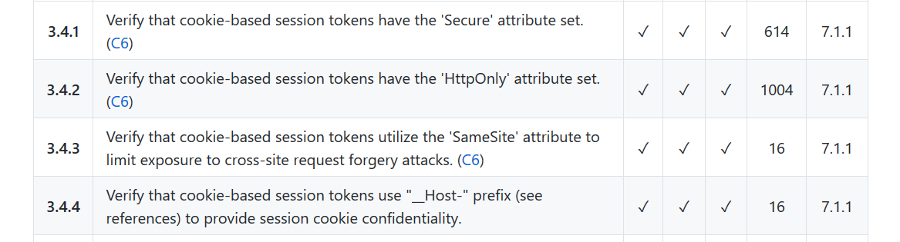
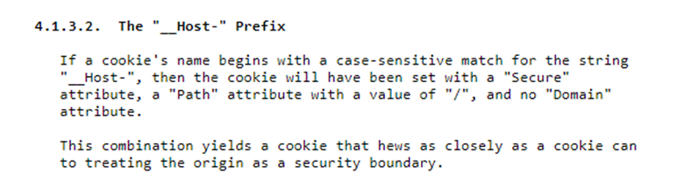
V3 Session Management
https://tools.ietf.org/html/draft-ietf-httpbis-rfc6265bis-03
Notes:
Cutting edge
https://tools.ietf.org/html/draft-ietf-httpbis-rfc6265bis-03
Secure, simple path and no domain

Slide 29
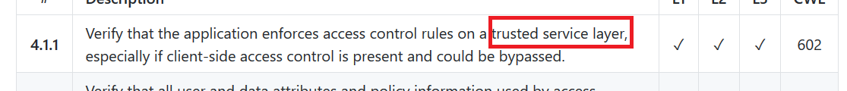
V4 Access Control
Covers API access control security
Covers serverless and cloud access control (”server-side” is gone)
Notes:
Where do you verify access control? – Not the server-side anymore

Slide 30
V5 Validation, Sanitization, and Encoding
Major revamp
Divided into easy to consume sections
Standardized Input and Output Pipelines
Input validation for modern applications and APIs
Output encoding is the new old hotness
Injection prevention (including XXE and XML attacks)
SSRF is the new hotness
Deserialization is the new hotness
Notes:
XXE is everywhere
SSRF is everywhere
Deserialization is dangerous

Slide 31
V6 Stored Cryptography
Notes:
Helps consider what is risky data
Allow reconfiguring algorithms
Secrets Management emphasis

Slide 32
V6 Stored Cryptography
Data classification – only encrypt the things you need
Algorithm agility
Random values
Secret management (i.e. HSMs, TPMs, OS key stores)
Notes:
Helps consider what is risky data
Allow reconfiguring algorithms
Secrets Management emphasis

Slide 33
V7 Error handling and Logging
It’s about reducing the time to detect breaches
Don’t log everything, but make it easier to detect breaches
Log protection
User friendly error handling improvements
Notes:
Time to detect, slow SQLi story
Don’t log sensitive data, facebook, twitter

Slide 34
V8 Data Protection
Protecting the most important data assets
Sensitive Private Data Protection
Covers many technical requirements for GDPR and other privacy laws
Client side protection (HTML 5 local storage etc)
Notes:
Focussed around guidance for GDPR technical controls
Other data protection requirements

Slide 35
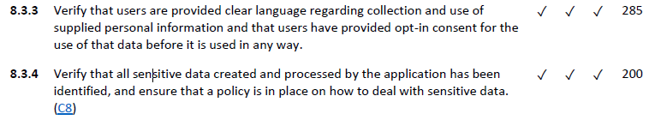
V8 Data Protection
Notes:
8.3.x GDPR
8.1.4 access/logging, normal use?

Slide 36
V9 Communications Security
Now DevSecOps friendly
No more building a secure chain / path … what does that even mean?
Easier to comply … automatically
TLS all the things
Use modern configuration builders
Use the verification tools you use today
Notes:
Removed complexities of building up chain/path
Removed HPKP
Focus on current leading practice
Use updated tools and config builders

Slide 37
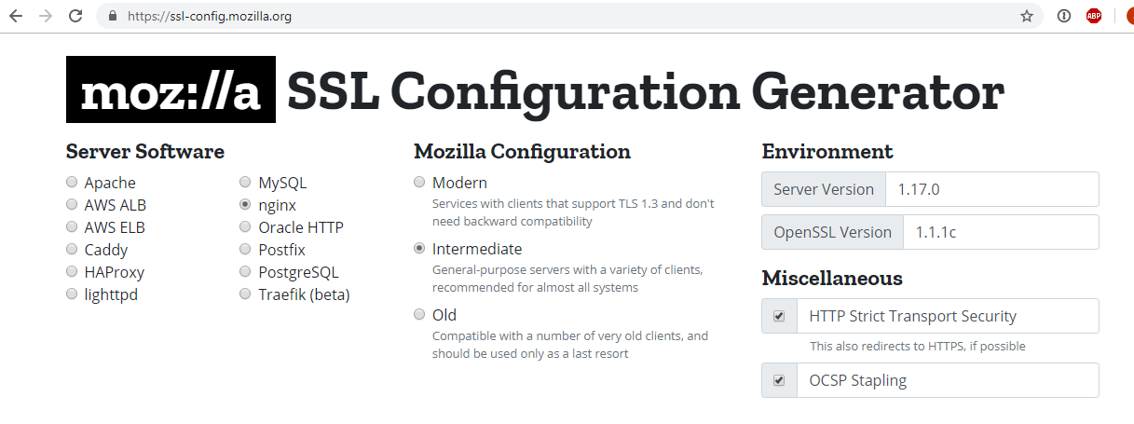

Slide 38

V10 Malicious Code
Notes:
Tools at the build time to detect timebomb functions, unexpected I/O or network, etc
Analytics JS
Logic, hard manual review stuff (L3)

Slide 39
V10 Malicious Code
Major update to this section to cover more than just time bombs and Easter eggs
Detect malicious code introduction
Continuous detection through building
Privacy invading libraries
Malicious business logic, such as salami attacks
Privacy invading permissions (camera, location, microphone, contacts, etc)
Mostly Level 3 except the Application Integrity Controls
Notes:
Tools at the build time to detect timebomb functions, unexpected I/O or network, etc
Analytics JS
Logic, hard manual review stuff (L3)

Slide 40
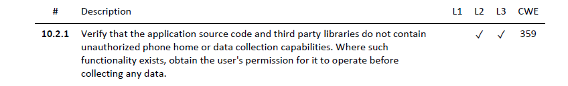
V10 Malicious Code
Notes:
Analytics libraries
Can scrap a lot of your page

Slide 41
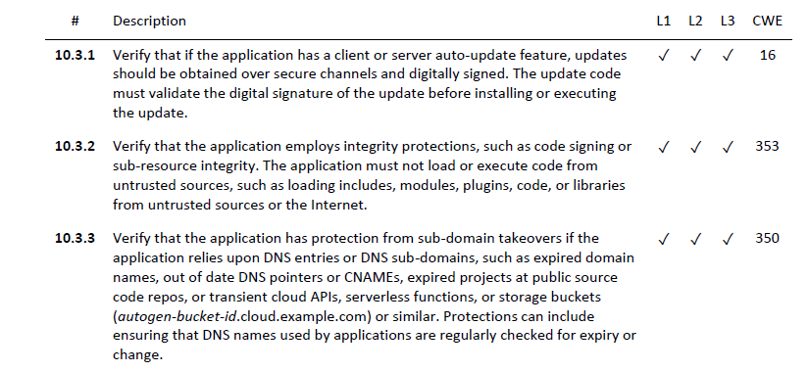
V10 Malicious Code
Notes:
Update process
Code provenance
Sub-domain takeovers

Slide 42
V11 Business Logic Verification
Key considerations:
Are steps being performed in the right order?
Are inputs within normal limits?
Are steps performed in “human time”? (not fast like an automated tool)
Are anti-automation controls being used
Threat model (attack driven design) business logic risks
Race conditions that might affect business logic (TOCTOU)
Monitoring, alerting, and detection of unusual business logic events
Notes:
Building common sense into the application
Would a human do this?
Race conditions back in
Detect >> NEXT SLIDE

Slide 43
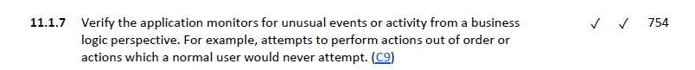
V11 Business Logic Verification
Notes:
High signal alerts
Noise - Random scanners and junk
Real evidence of an attacker attempting to manipulate

Slide 44

V12 Files and Resources

Slide 45
V12 Files and Resources
Major revamp
Architecture items moved to architecture
Configuration items moved to configuration
Upload - Size and number
Contents and integrity
Storage, including malicious file detection
Execution, including LFI, RFI, and SSRF
Download

Slide 46
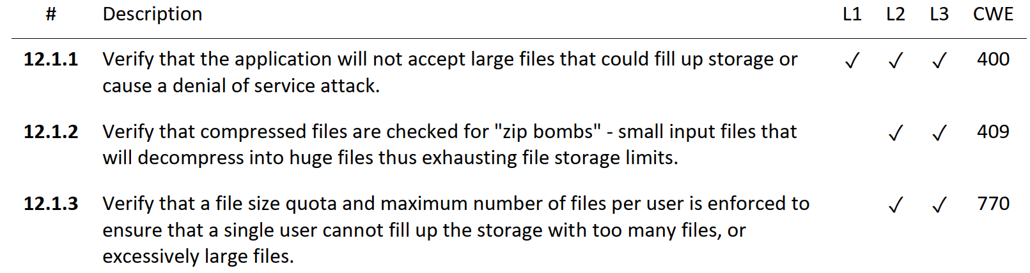
V12 Files and Resources
Notes:
Previously, this might have been DoS
Now, this could cost real money

Slide 47
V13 API Security
Total revamp
General controls include common sense API controls
Must be read in conjunction with authentication, authorization and session management
RESTful includes schema validation, CORS and origin attacks
SOAP – fewer more impactful items, far clearer, and not obfuscated
GraphQL and Web Service Data Layer

Slide 48
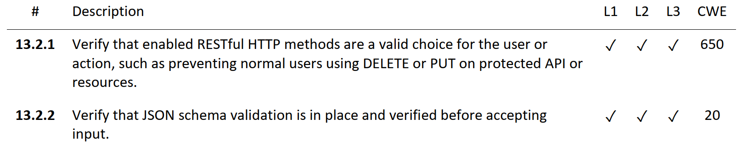
V13 API Security
Notes:
Schema validation

Slide 49
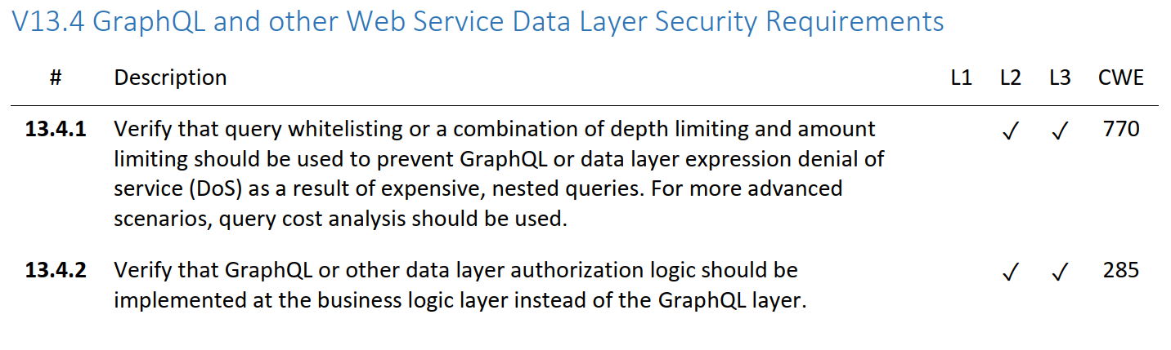
V13 API Security
Notes:
GraphQL usage is growing and there are interesting attacks there

Slide 50
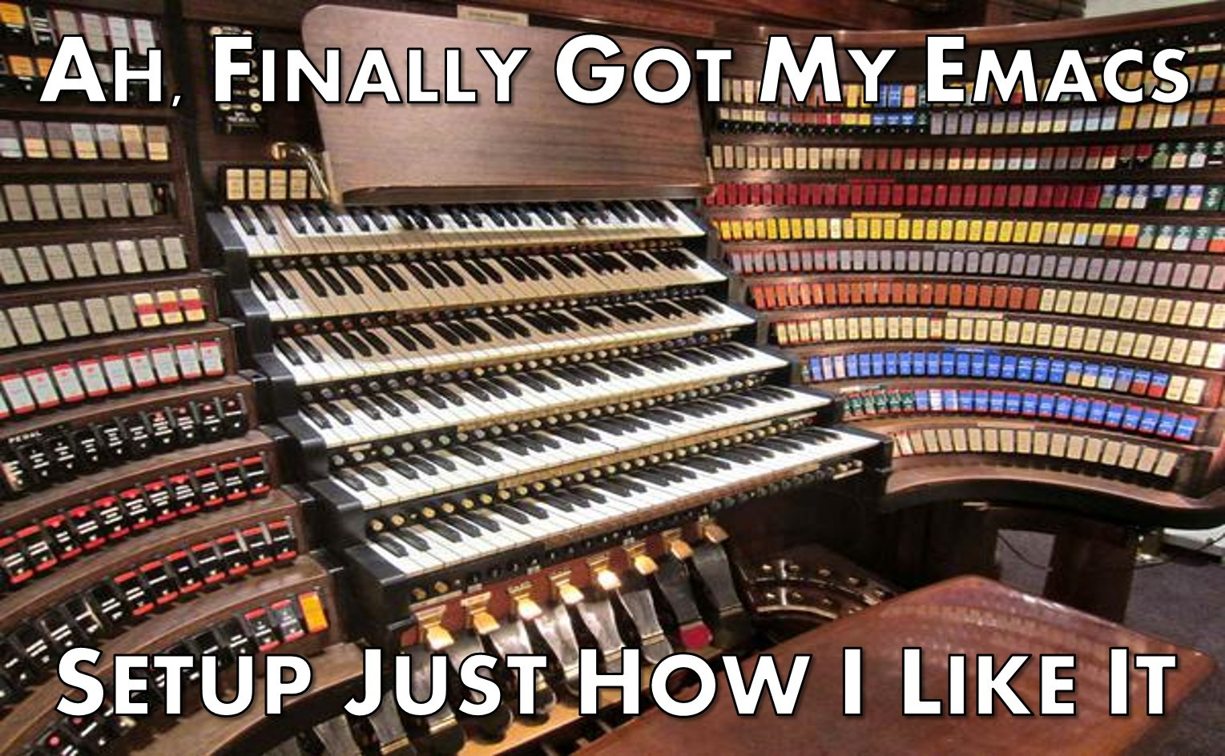
V14 Configuration

Slide 51
V14 Configuration
Major revamp
Repeatable, Continuous integration, continuous deployment
Support for DevSecOps culture and agile practices
Dependency checks mandated
HTTP Security Headers

Slide 52
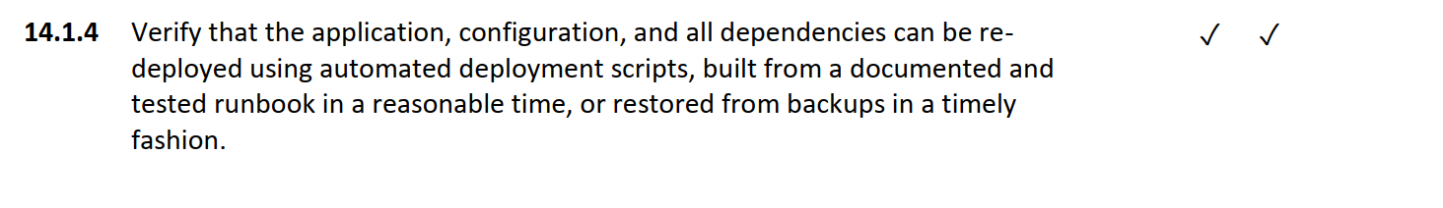
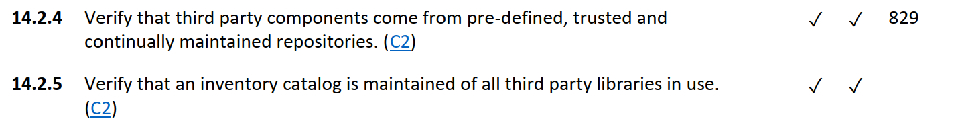
V14 Configuration
Notes:
Auto, repeatable deploy
3rd party reliance

Slide 53
Mobile ASVS
Focused on mobile specific issues (client-side and transport security)
Application server side should be assessed using the main ASVS
Similar structure to main ASVS
Different team – the OWASP Mobile Security project
Very closely linked to the OWASP Mobile Security Testing Guide
Provides platform independent guidance

Slide 54
I’m in. How do I use it?

Slide 55
Generally Accepted Security Practices
Secure code review
Security architecture
Integration testing
Peer coding checklists
Developer training
Unit testing
Hybrid reviews
DevSecOps automation
Vulnerability programs
Consultant training
Tool Benchmark
Secure coding checklist
Penetration test
Deployment checklist
Functional constraints
Planning Sprint Assistance
Non-functional and functional features
Supplier Benchmarking

Slide 56
How do I use it?
Use it as is or fork it
Level 1 – entry level, penetration testing
Level 2 – most apps
Level 3 – apps that can kill you or run the world economy
Deep standards have no bounds

Slide 57
How to get involved
Grab a copy today and start to migrate from earlier versions and T10
We need translations. Please join the #project-asvs channel on OWASP Slack
We need case studies! If you use ASVS, we’d love to hear from you!
Create issues or pull requests if you identify issues

Slide 58
When can I get it?
The ASVS 4.0.1 Final is available now!
OWASP Wiki – Word, PDFs, CSVs, and Hot Linkable markdown
GitHub – Most Recent Static Version is in the 4.0.1 branch
GitHub – Development Version is in the master branch
You can also get the base version of this presentation so you can give this to your local chapter, school, college, or workplace! (Thanks again to Andrew van der Stock!)

Slide 59
Thank you
josh.grossman@owasp.org (ASVS) | josh@appsec-labs.com ($dayjob)
@joshcgrossman

